Slide 1
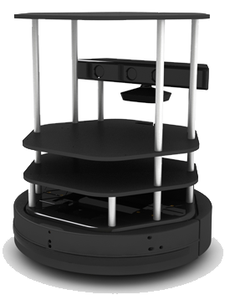
Robotics and Perception
CMSC498F, CMSC828K
Lecture 7:
Robots in ROS

Slide 2
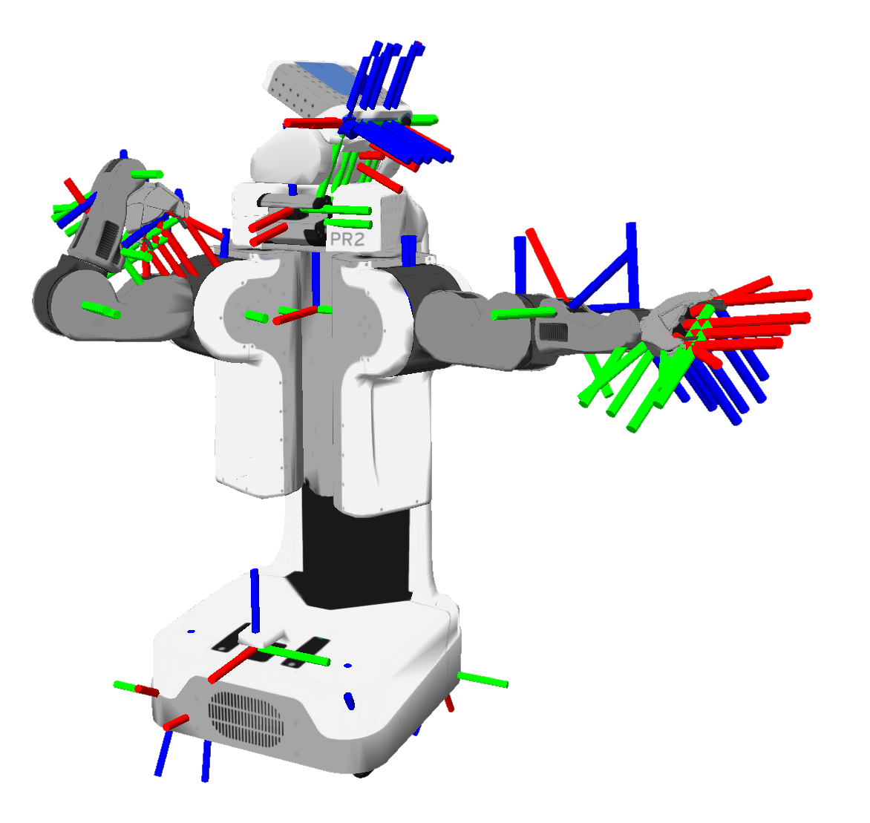
Representing robot state
A robot consists of many moving and static parts e.g. base, wheels, cameras, manipulators, grippers etc.
Each part can be associated with a coordinate frame.
Robot state can be represented by the poses of these frames.
Notes:
Our robot has many static and moving parts. We want to control this robot. Let’s take a simple example. Let’s say our robot is moving towards some goal and we are using proportional control to control it. To use it we have to know what is the position of the robot relative to the goal point in the real world. Let’s have another example. We have a robot with a gripper and we have a camera and we have found a bottle of water using our camera. Now we want to grasp it. In order to move the gripper to the bottle we have to know where the gripper is right now. In other words, if we want to control the robot, we need to answer the question: what is the current state of the robot? This includes both it’s state relative to the real world and it’s own internal state.
So how do we represent the robot state. Our robot consists of many moving parts. Each one of them can be associated with a coordinate frame. We can represent the state of the robot using the relative poses between these frames.
What other information about these coordinate systems we might need? Consider the same example of a robot moving towards a goal. Let’s say we are far away from our goal point and our robot is not moving. Our proportional control will tell it to immediately start moving with maximum speed. Not good! We need to know the velocity of the robot relative to the map to make sure that the robot moves smoothly.
In order for us to control the robot we must be able to answer the question what is the current state of the robot. How do we even

Slide 3
Representing robot state
A robot consists of many moving and static parts e.g. base, wheels, cameras, manipulators, grippers etc.
Each part can be associated with a coordinate frame.
Robot state can be represented by the poses of these frames.
More sophisticated control schemes may require time derivatives of the poses i.e velocity, acceleration and jerk.
Notes:
Our robot has many static and moving parts. We want to control this robot. Let’s take a simple example. Let’s say our robot is moving towards some goal and we are using proportional control to control it. To use it we have to know what is the position of the robot relative to the goal point in the real world. Let’s have another example. We have a robot with a gripper and we have a camera and we have found a bottle of water using our camera. Now we want to grasp it. In order to move the gripper to the bottle we have to know where the gripper is right now. In other words, if we want to control the robot, we need to answer the question: what is the current state of the robot? This includes both it’s state relative to the real world and it’s own internal state.
So how do we represent the robot state. Our robot consists of many moving parts. Each one of them can be associated with a coordinate frame. We can represent the state of the robot using the relative poses between these frames.
What other information about these coordinate systems we might need? Consider the same example of a robot moving towards a goal. Let’s say we are far away from our goal point and our robot is not moving. Our proportional control will tell it to immediately start moving with maximum speed. Not good! We need to know the velocity of the robot relative to the map to make sure that the robot moves smoothly.
In order for us to control the robot we must be able to answer the question what is the current state of the robot. How do we even

Slide 4
tf
tf is a ROS package that keeps track of multiple coordinate frames over time.
Can answer questions like:
What is the current pose of the base frame of the robot in the map frame?
What is the pose of the object in my gripper relative to my base?
Where was the head frame relative to the world frame, 5 seconds ago?

Slide 5
tf tree
/map

Slide 6
tf tree
/map
/robot/base_link

Slide 7
tf tree
/map
/robot/base_link
...
/robot/camera

Slide 8
tf tree
/map
/robot/base_link
...
...
/robot/camera
/robot/gripper

Slide 9
tf tree
/map
/robot/base_link
...
...
/robot/camera
/robot/gripper
T?

Slide 10
tf tree
/map
Forward transform
Inverse transform
/robot/base_link
...
...
/robot/camera
/robot/gripper
T?

Slide 11
tf
Individual nodes publish their transform data on the /tf topic.
Transform listeners subscribe to /tf and aggregate all of the transform information of the system.
Transform listener class:
tf.TransformListener()
Lookup a transform between two frames at a given time:
lookupTransform(source_frame, target_frame, time)
Wait till a transform between two frames becomes available:
waitForTransform(source_frame, target_frame, time)

Slide 12
tf
Pose message:
[geometry_msgs/Pose]:
geometry_msgs/Point position
float64 x
float64 y
float64 z
geometry_msgs/Quaternion orientation
float64 x
float64 y
float64 z
float64 w

Slide 13
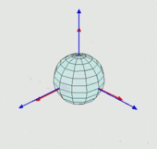
Orientation representation: Euler angles
Euler angles represent orientation as rotations around X, Y and Z axes:
α ∊ [-π, π) rotation around Z axis
β ∊ [-π/2, π/2) rotation around X axis
γ ∊ [-π, π) rotation around Y axis
Advantages: intuitive, compact representation
Disadvantages: gimbal lock

Slide 14
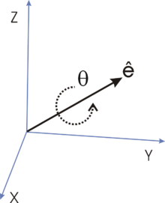
Orientation representation: Quaternions
Any rotation in 3D can be represented as a combination of a vector u (the Euler axis)
This representation can be “easily” converted to quaternions:

Slide 15
Orientation representation: Quaternions
Rotation is represented with 4 numbers: x, y, z, w
Quaternions avoid gimbal lock!
Conversion from quaternions to Euler angles in ROS:
(alpha, beta, gamma) =
tf.transformations.euler_from_quaternion(x,y,z,w)

Slide 16
tf listener example
1 #!/usr/bin/env python
2 import rospy
3 import tf
4
5 def tfListener():
6 # Initialize node
7 rospy.init_node(tf_listener, anonymous=True)
8
9 # Initialize transform listener
10 tfListener = tf.TransformListener()
11
12 # Wait for the transform to become available
13 tfListener.waitForTransform("/odom", "/base_footprint", rospy.Time(10))
14
15 # Get the current transform
16 (position, orientationQ) = tfListener.lookupTransform("/odom", "/base_footprint", rospy.Time(0))
17
18 # Convert orientation from quaternion to Euler angles
19 orientationE = tf.transformations.euler_from_quaternion(orientationQ)

Slide 17
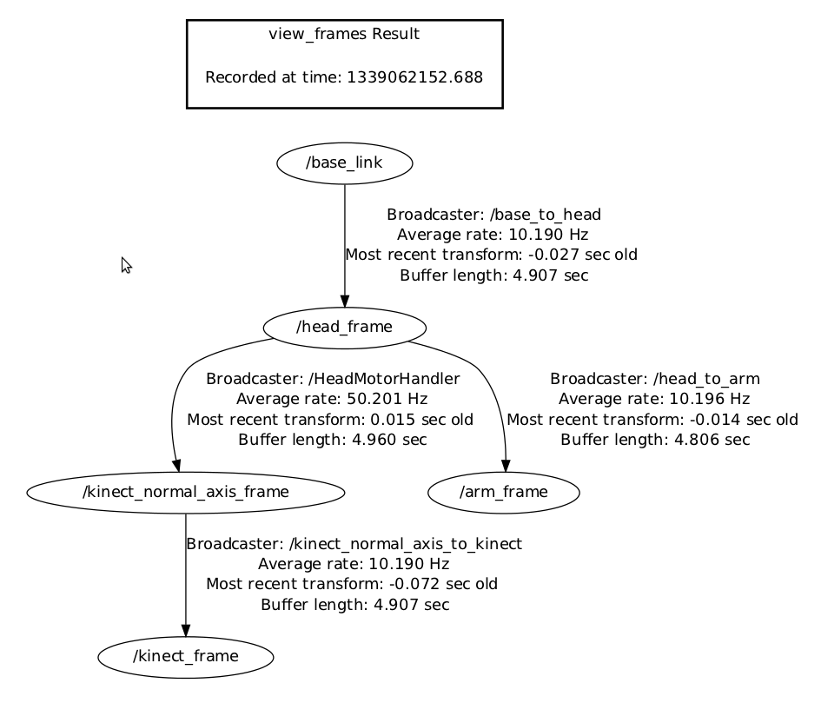
tf command line tools
Print transform between two frames:
rosrun tf tf_echo source_frame_id target_frame_id
Print update information about transforms:
rosrun tf tf_monitor (all frames)
rosrun tf tf_monitor source_frame_id target_frame_id
Create a document with the current transform tree:
rosrun tf view_frames

Slide 18
Rviz
3D visualization tool for ROS.
Can visualize:
robot state (coordinate frames, robot model)
sensor data (image, laserscan, pointcloud)
environment map, robot path
Crucial tool for debugging.
Controlled using a GUI.
Running rviz:
rosrun rviz rviz

Slide 19
Turtlebot robot
Consists of:
Kobuki base
Asus Xtion Pro RGB-D sensor
Netbook
Mounting hardware
Specialized ROS packages that implement basic functions.
An open source robotic platform for research and education.
Online tutorials:
http://wiki.ros.org/turtlebot/Tutorials/indigo
Notes:
Show the robot.
Kobuki base - wheels, odometry, batteries, external power, bumper sensors, cliff sensors.
RGBD sensor - main perception source
Netbook - the brain of the robot that connects to hardware and runs ROS

Slide 20
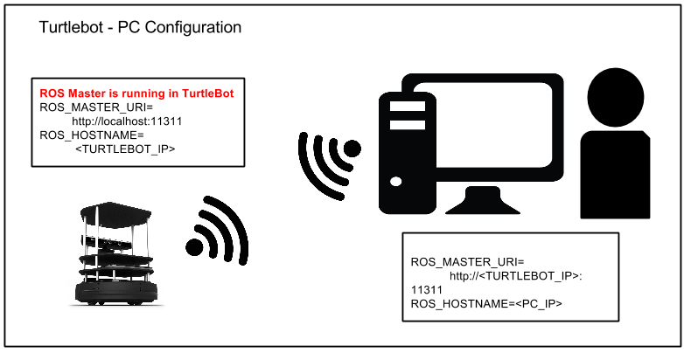
ROS networking
Running a robot requires two computers running ROS:
Robot laptop
roscore
drivers
Control laptop
debugging
high level control
Robot laptop is controlled remotely using SSH.
To setup communication between them both must be on the same network and know each other’s IP addresses.
See Piazza for detailed instructions on network setup.

Slide 21

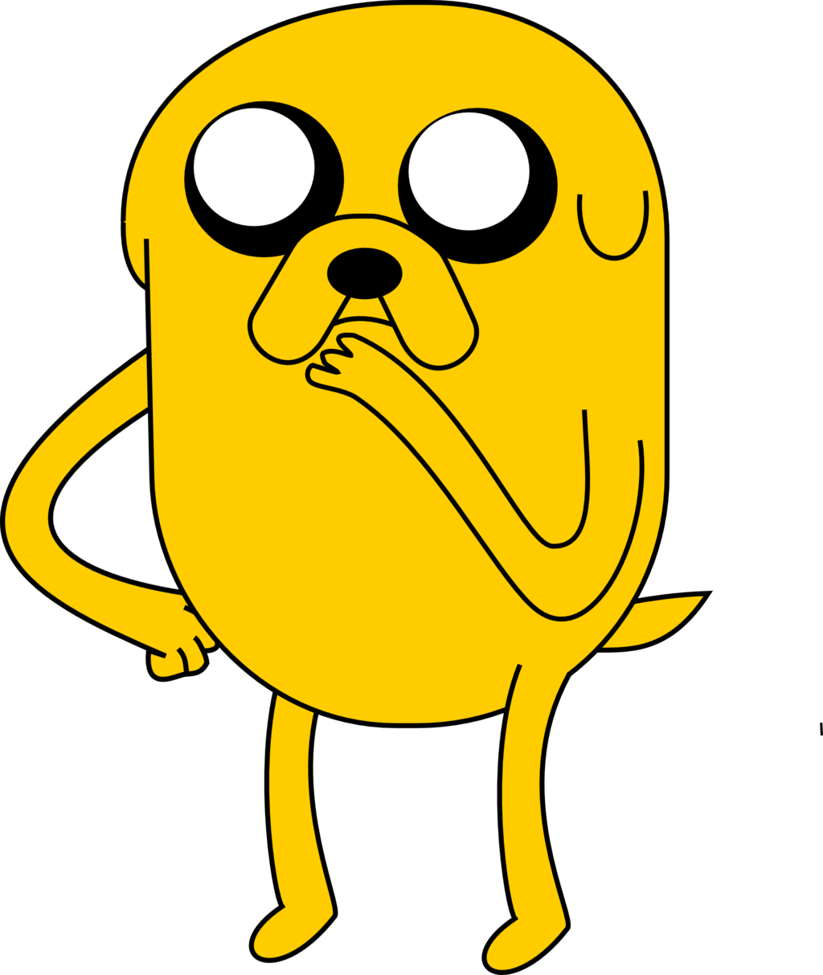

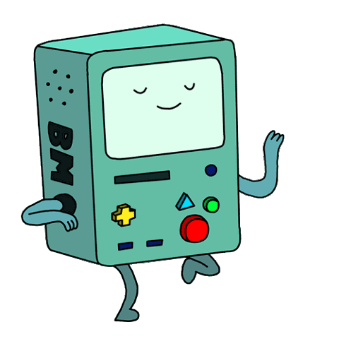
Available robots
Finn
Gunter
BMO
Jake
Notes:
Show the robot.
Kobuki base - wheels, odometry, batteries, external power, bumper sensors, cliff sensors.
RGBD sensor - main perception source
Netbook - the brain of the robot that connects to hardware and runs ROS

Slide 22
Turtlebot demonstration

Slide 23
Gazebo
Gazebo is a 3D dynamic simulator
Simulates the robot and it’s environment.
Can generate robot sensor data.
Uses a physics engine to simulate the interaction of the robot and the environment.
Essential tool for robot algorithm development.

Slide 24
Gazebo demonstration

Slide 25
The end!
Questions?

